Slide 1
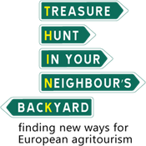
Final Presentation of PR1
A FRAMEWORK OF A TRAINING FOR YOUNG EUROPEANS IN
agritourism
The main objective is to list and prioritise the key competences that agricultural entrepreneurs should have in order to be able to develop new tourism offers based on agriculture and the experience gained in agriculture.

Slide 2
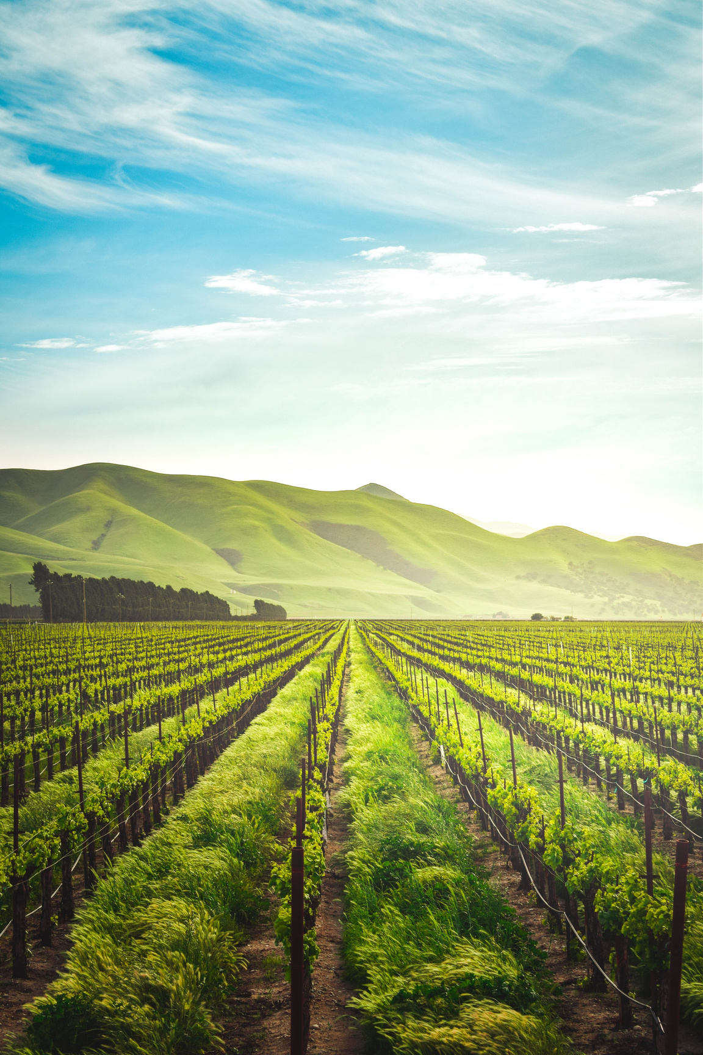
Project Result 1
A collection of topics linked on:
specific skills
learning and training methods that will be developed in the following phases of the project
The activities carried out aim to identify:
competences required to become an agritourism expert
specific needs perceived by agricultural entrepreneurs to stimulate the creation of a new tourist offer based on the elements of rural life

Slide 3
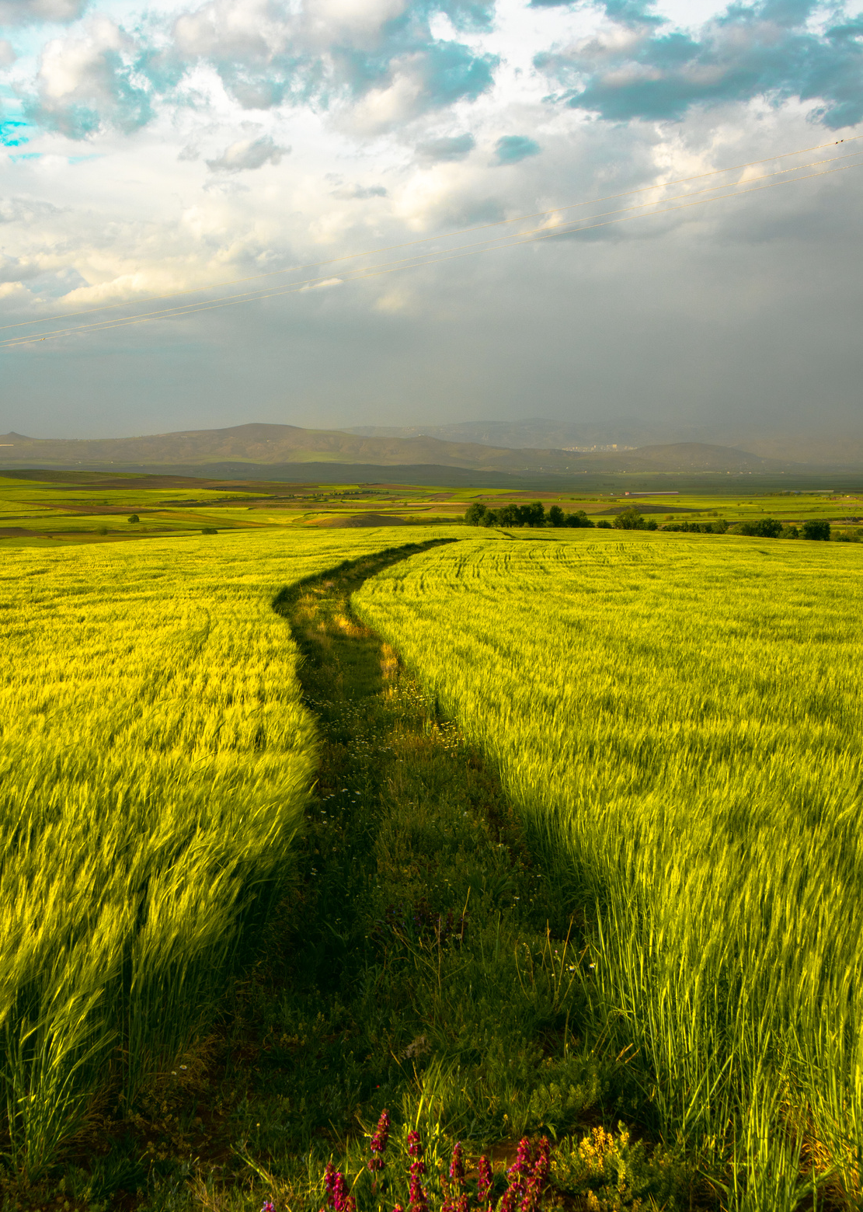
Two different tasks
European experiences/best practises/case studies
using in agritourism in formal and non-formal learning environment
Interviews with agritourism experts
describing the necessary tourism challenges in agritourism that would facilitate the development of the new tourism offers based on their previous experiences, etc.

Slide 4
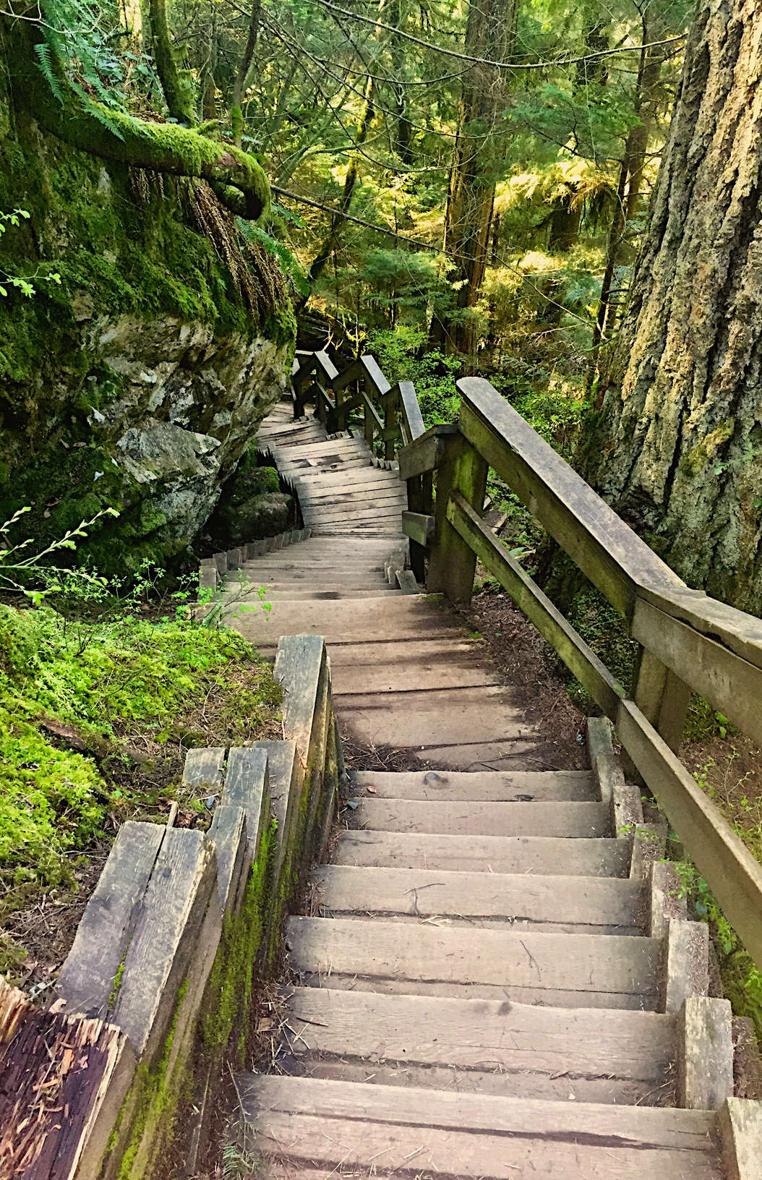
European experiences/best practises/case studies
Collection of consistent and coherent contributions from all partners based on:
case studies of agritourism in each country
different definitions of agritourism
a presentation of the existing agritourism offer at national level
the identification of training needs and skills of young (or aspiring) agritourism entrepreneurs

Slide 5
Sweden
Naturturismföretagen "Companies for Nature Tourism"
Agritourism or agriturism in Swedish is a term that is not used very often in Swedish literature, and even less so in spoken language.
3-year upper secondary programme in nature tourism
Case studies
Tiraholm Fish farm
Skullaryd Moose Park

Slide 6
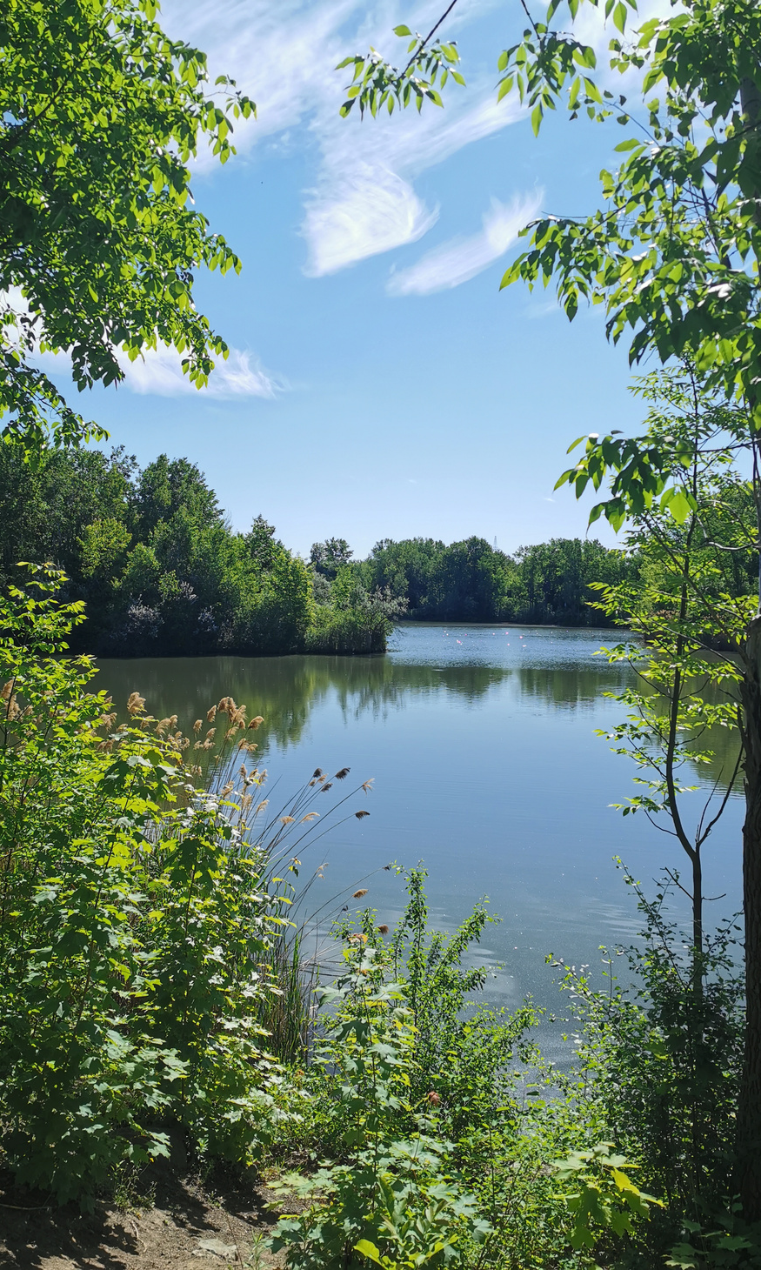
Greece
The roots of agritourism in Greece lie in various forms of rural tourism
Religious holidays (Easter, local Saints' days)
Weekends
And city dwellers visit the countryside to meet relatives and friends or to pursue various outdoor activities
Case Studies
Agritourism Cooperative Entrepreneurship
Students' training on new methods of tourism promotion and management of clientele of Agritourism Lodgings
Next Destination Balkans: Agritourism Landscapes Development (LANDS)

Slide 7
Spain
Rural tourism in Spain appeared in the 1980s, with the emergence of new rural tourism initiatives in autonomous communities.
Agritourism is an economic activity with a great projection in Spain
It can contribute greatly to the economic development of rural areas, local development, and the conservation of the historical, cultural, and environmental heritage of the rural areas of the country.
Case Studies
Village Life
Can Gel
Cudaña Farm "Only love beats Cudaña's milk"

Slide 8
Italy
Agritourism is an activity related to agriculture, but not agricultural in itself, therefore the aid scheme for this activity is regulated under European legislation by the 'de minimis' rule.
Case Study
Masserie Didattiche di Puglia

Slide 9
Bulgaria
Agricultural tourism (agritourism) in Bulgaria is a subset of the rural tourism. It is known by various names, depending on the region and type of farming.
Case studies
European project “Back to Nature”
A young farmer diversifies into rural tourism activities in Bulgaria

Slide 10
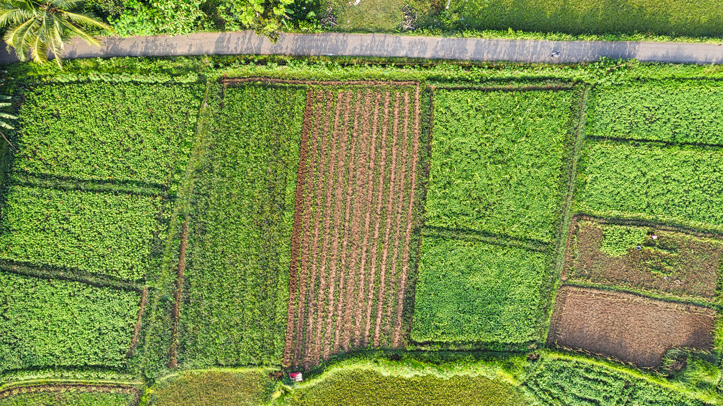
Interviews with agritourism experts
The experts described the necessary tourism challenges that would facilitate the development of the new tourism offers based on their previous experiences, talked about the specific competences and skills needed for the sector, talked about the techniques or tools that would-be entrepreneurs use to promote agritourism businesses and activities, and mentioned possible obstacles they might face.

Slide 11
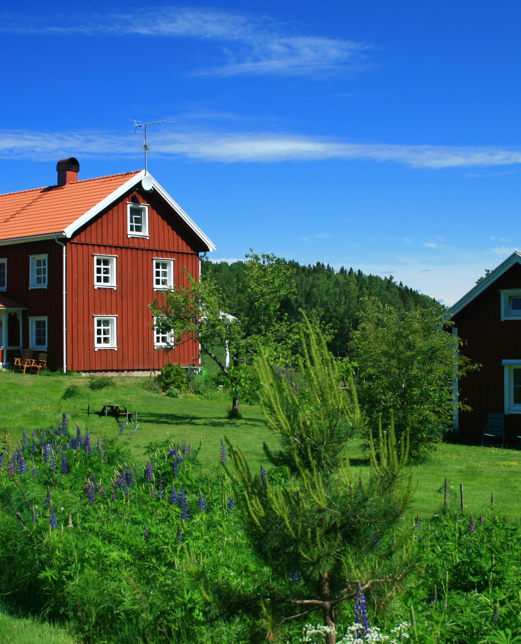
Sweden
Juha Rankinen from Ethnosphere Outdoors
Erik Öster from Skullaryd Moosepark
Malin Ekwall from Tiraholm Fishfarm
The main characteristics that wannabe agritourism entrepreneurs should have:
Interpersonal skills and organisational skills, language skills, the ability to satisfy customers and deal with authorities and paperwork were also mentioned as important by the interviewees.
love for nature and rural life
genuine passion
promotion of care
sincere concern for the local environment and its sustainable management
Intimate knowledge of the local ecosystem and its sustainable use
In terms of techniques and tools for advertising and promotion, digital techniques, websites and social media are considered most important.

Slide 12
Greece (1/2)
Serafeim Felekis
Former President of Tzoumerka, Acheloos Valley, Agrafa and Meteora National Park
Alexis Boytzas
Family restaurant and small cheese factory
Dimitris Chandras
Owner of a family hotel in a mountainous destination
George H.
Owner of a family-run hotel on an island near Athens
P.D.
Vocational school teacher, experienced in teaching tourism courses
P.S.
45 years of experience in the tourism industry in general

Slide 13
Greece (2/2)
Characteristics of Wannabe Agripreneurs
Love and passion for what they do or want to do, theoretical and practical knowledge, perseverance, objectivity, following their heart and instinct, understanding and patience.
Skills in tourism
Love for nature
Not just an entrepreneurial activity
Knowledge about hospitality and customer service
Social Media
The importance of social media and the internet in general is highlighted here.
Accessibility
In some disadvantaged mountain areas, the main problem is access and subordinate structures.
Funding Problems
The lack of funding or educational programmes specifically for agritourism is a big issue.
Other Obstacles
Competition, differentiation of competitors, bureaucracy and administrative problems of the country

Slide 14
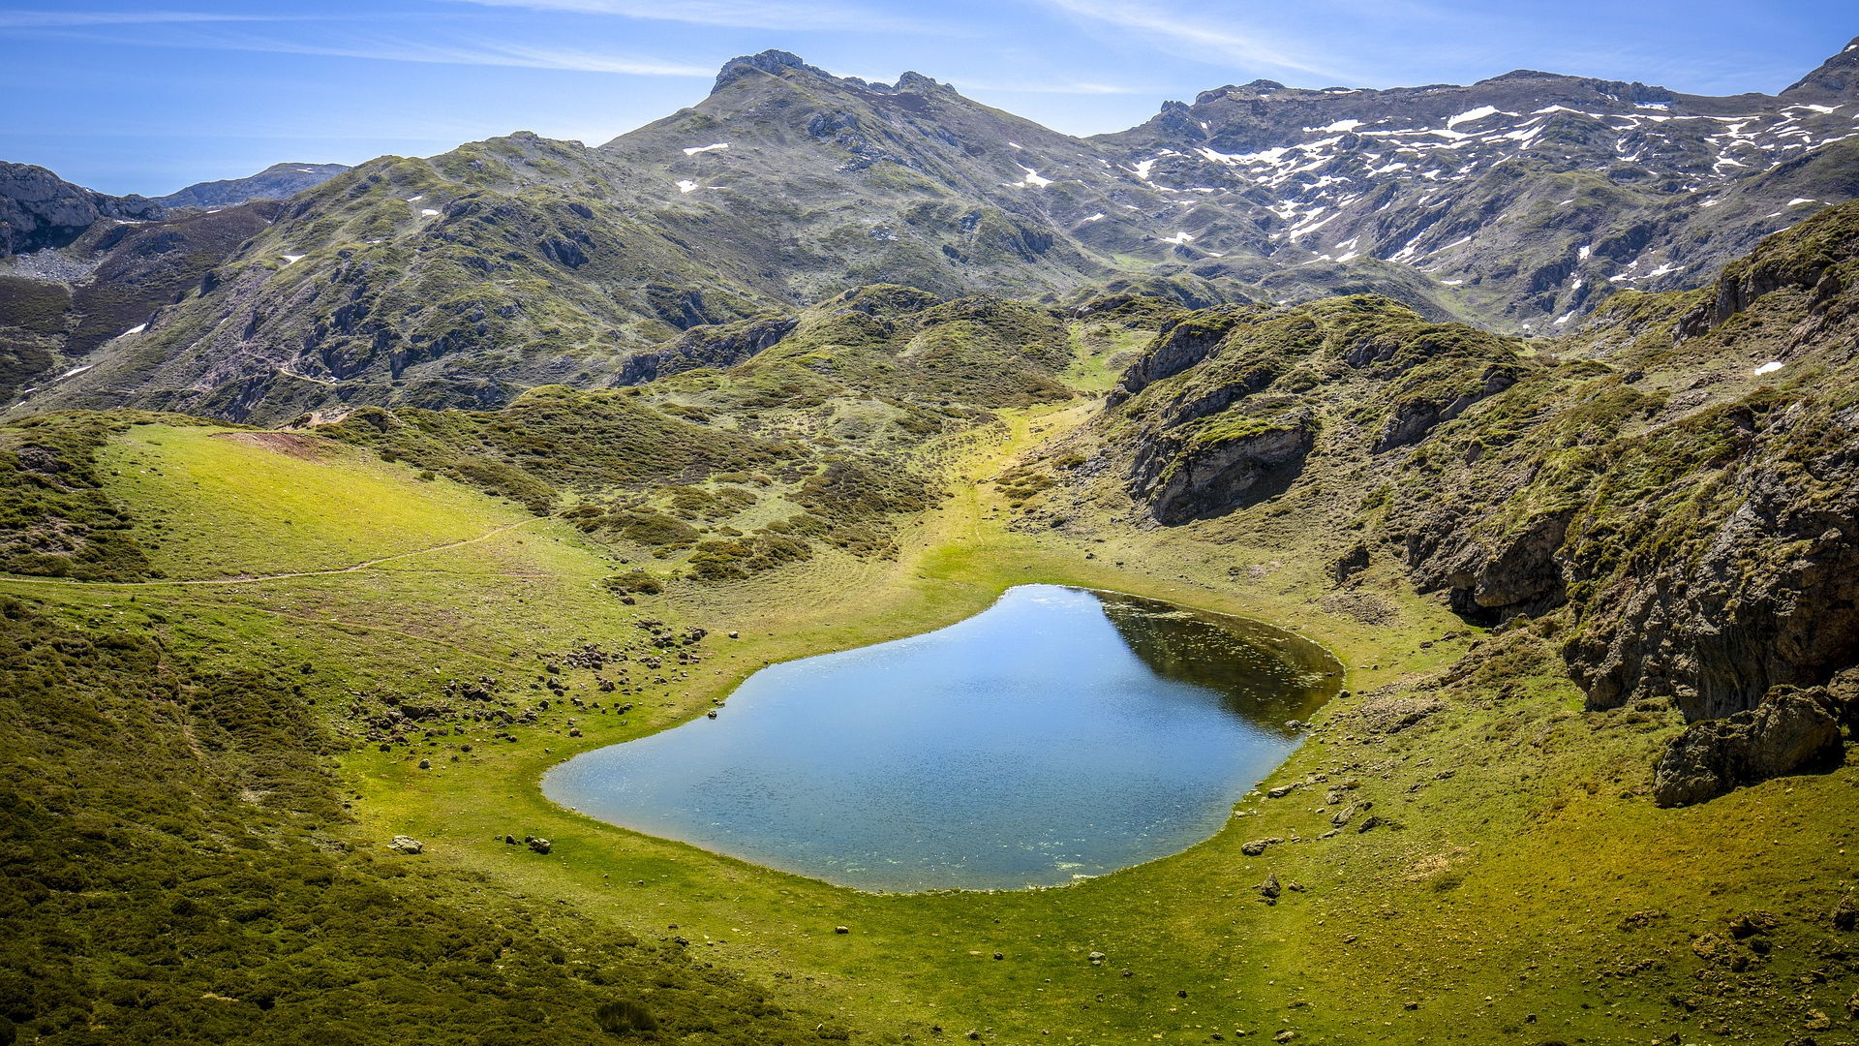
Spain
Teresa
Owner at Huerto Ribera
Dorita
Co-owner of Llucmançes Gran in Menorca
Marketing responsible of Horta Viva
Conclusions
Passion, enthousiasm and motivation, patience and creativity are the main characteristics of wannabe agritourism entrepreneurs
In terms of skills, there are no essential specific skills to start an agritourism business. However, some skills can be considered as languages, social media, empathy and patience.
Implementation skills, organisational skills, planning and commitment are some of the most important skills for agripreneurs.
Especially digital tools and techniques such as a well-organised website, digital marketing, SEO and SEM strategies, social media and booking platforms.

Slide 15
Italy
Gianpio Arcomano
Owner of a family farm
Domenico Cardinale
Manager of a farm in Matera
Maria Laura Castoro
Manager of a family organic farm
Key Outcomes
The most important qualities that prospective agritourism entrepreneurs should have:
Passion
Determination
Patience
Perseverance
Foresight in the industry
Tourism Skills
The mentality of hospitality, mastery of foreign languages, knowledge of how to intercept foreign markets and knowledge of how to use the main intermediation platforms
Digital Tools
The importance of digital tools and techniques such as social media, the official websites, etc.
Obstacles
Excessive bureaucracy, the difficulty of finding economic resources and skilled and hardworking labour, and managing several activities at the same time

Slide 16
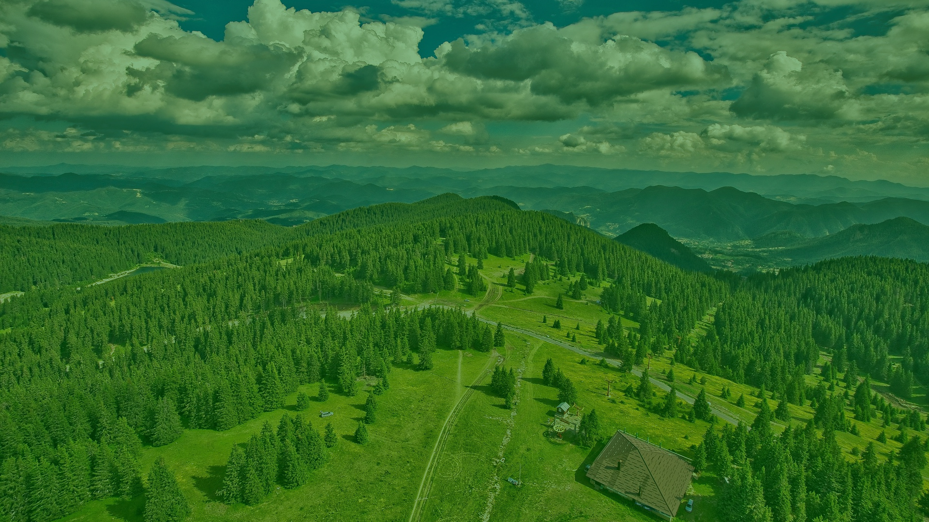
Bulgaria
Dr. Radostina Popova-Terziyska
Associated Professor in the Department of Management and Alternative Tourism, Faculty of Business Management
Key Outcomes
Additional Income
Agritourism offers farmers and other rural entrepreneurs an excellent opportunity to diversify and generate additional income through on-farm tourism activities.
Techniques and Tools
1. Putting signs along adjacent roads
2. Distributing information brochures at visitors’/tourist centres
3. Advertising at relevant events and conferences
4. Publishing short articles in local media
5. Using the advantages of the popular social media
Dr. Vladimir Piralkov
Professor in the Department of Management and Alternative Tourism, Faculty of Business Management
Knowlegde Skills
1. general knowledge on starting an agritourism business
2. Living and working in the digital era
3. Soft skills
Dr. Nikolay Neykov
Associated Professor in the Department of Management and Alternative Tourism, Faculty of Business Management
Obstacles
Some of the main obstacles are: Fear of failure; increasing competition from traditional tourism; limited access to national, European or international grants; lack of resources; lack of basic entrepreneurial skills and appropriate training in agritourism
Characteristics of Wannabe Agripreneurs
Perseverance and ability to stay focused and consisted
High determination and self-esteem
Readiness for lifelong learning, continuous personal and professional development, thinking out-of-the-box

Slide 17
Conclusions
Love and passion for agritourism, animals, the natural environment or for what they do in general is the key to everything
Perseverance, patience, self-confidence, enthusiasm and motivation, creativity, persuasiveness and adaptability, vision, the desire for continuous development are also important.
The most important tourism skills are knowledge of hospitality and customer service, a good knowledge of at least one foreign language, but also the ability to start and maintain a friendly conversation with visitors, and a general knowledge of how to start and run an agritourism/agriculture business in rural areas.
The techniques and tools that aspiring entrepreneurs should use to successfully market their agritourism business, are the digital tools, digital marketing, SEO and SEM strategies, social media and booking platforms, especially a well-?organised and updated website, social media pages, TripAdvisor, etc.
Bureaucracy is the biggest obstacle for agricultural (or would-be) agripreneurs, because it is usually overwhelming and discouraging.

Slide 18
THANK YOU
STUDY NATURE, LOVE NATURE, STAY CLOSE TO NATURE.

